Slide 1

ISDT CA1
Member(s):
Tenia Xu Yuan (P1935334)
Sebastian Pang (P1935631)

Slide 2
Game Name
Construction Site Safety Game

Slide 3
Theme
Simulation:
A simulation video game describes a diverse super-category of video games, generally designed to closely simulate real world activities. A simulation game attempts to copy various activities from real life in the form of a game for various purposes such as training, analysis, or prediction.

Slide 4
Background Information
The construction industry is known for being one of the most dangerous fields to work in. Out of every 5,000 private-industry worker fatalities, 20 percent are in construction. That means one out of every five worker deaths is construction-related!

Slide 5
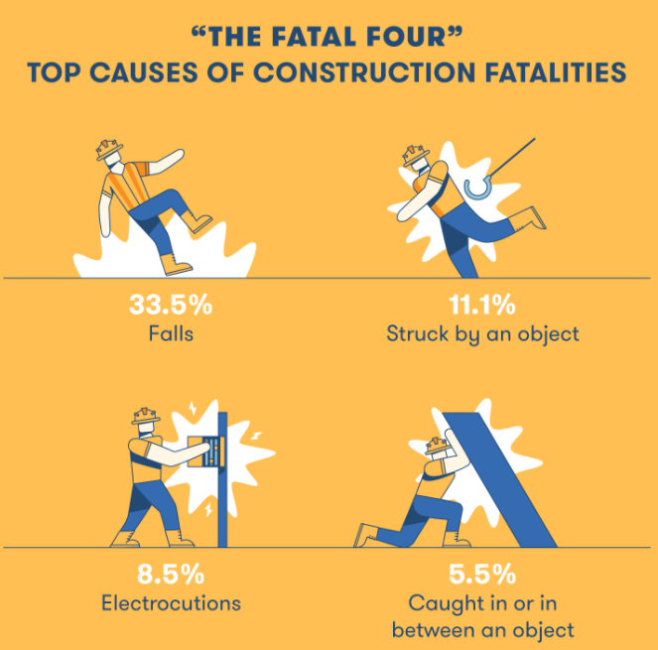
Background Information

Slide 6

Background Information

Slide 7
Summary of Game
There are total of 3 safety procedures found in the game and players are required to move around the map to locate the procedures and learn the correct method to prevent possible accidents from occurring.

Slide 8
Purpose of Game
Educate people on how to protect themselves and others on a construction site.

Slide 9
Target Audience
Preferably construction workers but may also apply to the public to gain more knowledge.

Slide 10

Controllers
Oculus Quest
Headset + 2 Controllers (L/R hand)

Slide 11
Safety Procedures
Safety Gear
Fire Safety
Gas Leak

Slide 12
Safety Procedure #1 – Safety Gear
Protection
Lessen likelihood of injury
Reduce exposure to hazards

Slide 13
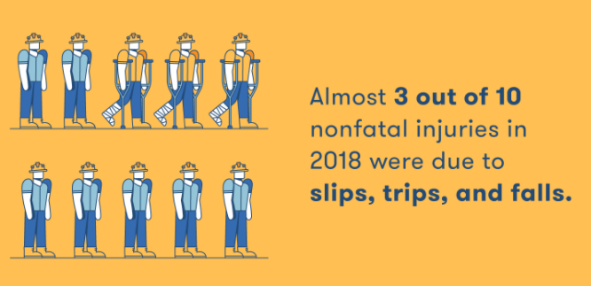
Safety Procedure #1 – Safety Gear

Slide 14
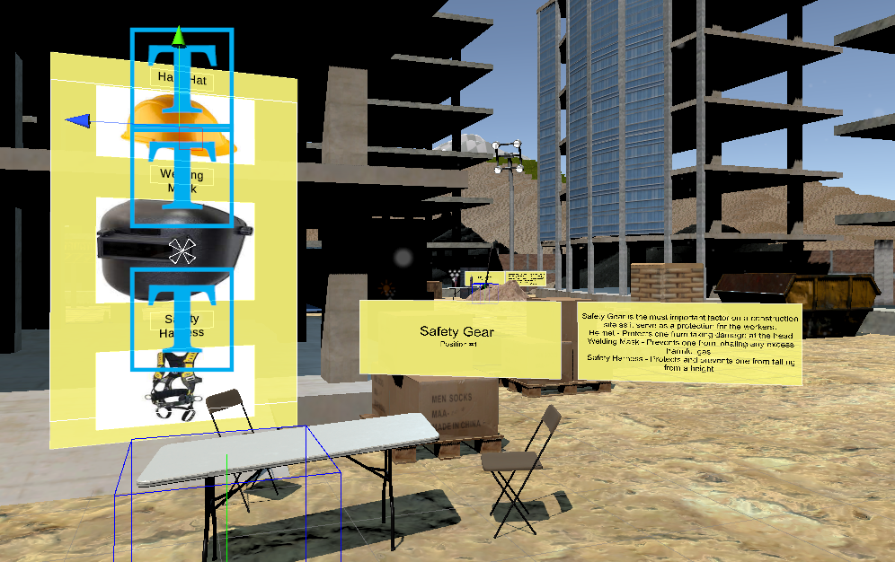
Safety Procedure #1 – Safety Gear

Slide 15
Safety Procedure #2 – Fire Safety
Preventing fire from occurring
Prevent explosion
Keep workers safe from a fire
Reduce damages
Save lives

Slide 16
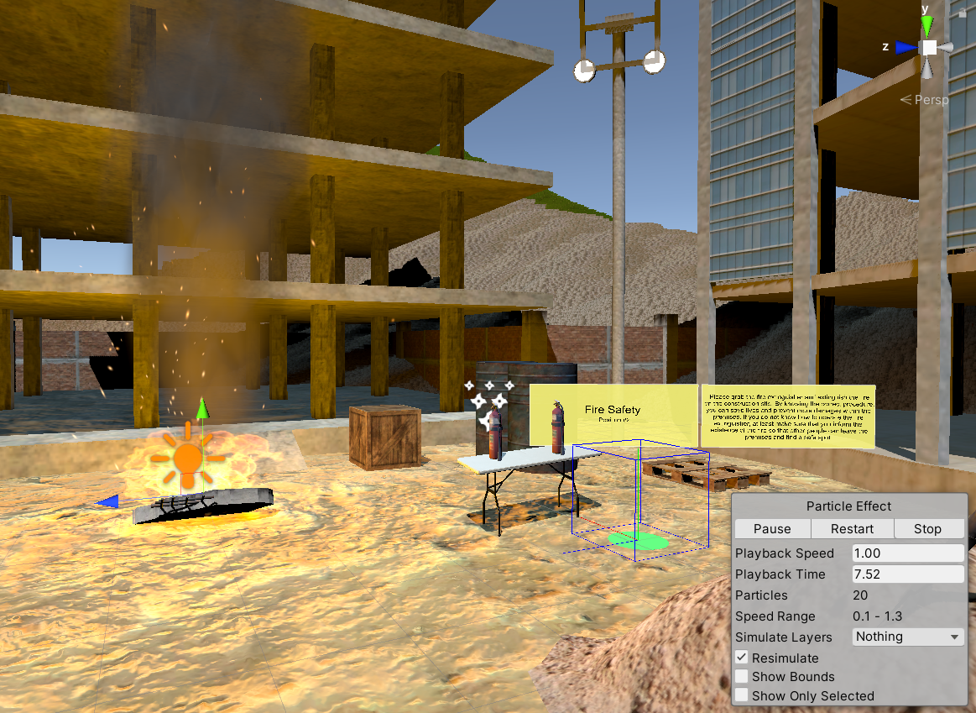
Safety Procedure #2 – Fire Safety

Slide 17
Safety Procedure #3 – Gas Leak
Prevent explosion
Keep workers safe from possible harmful gas
Save lives

Slide 18
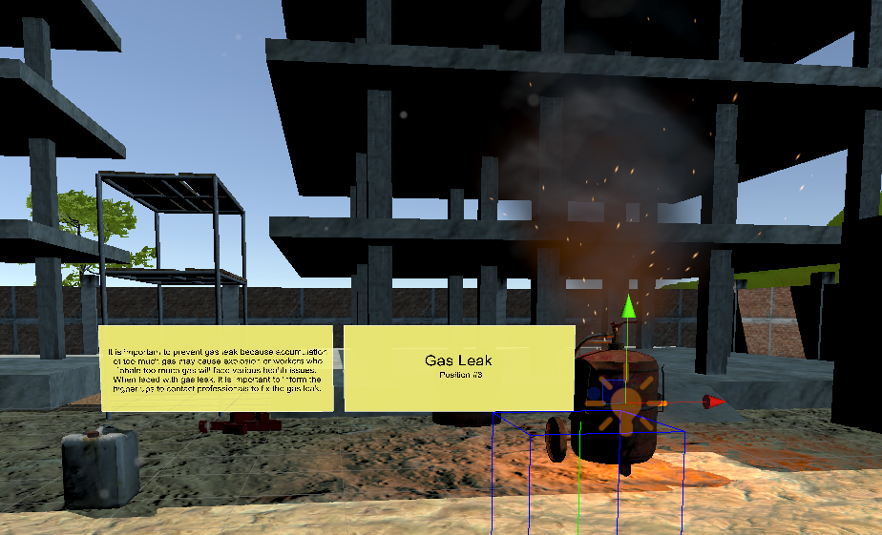
Safety Procedure #3 – Gas Leak

Slide 19
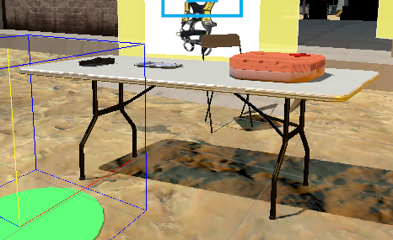
Safety Procedure #3 – Gas Leak
Notes:
<Describe using walkie talkie>

Slide 20
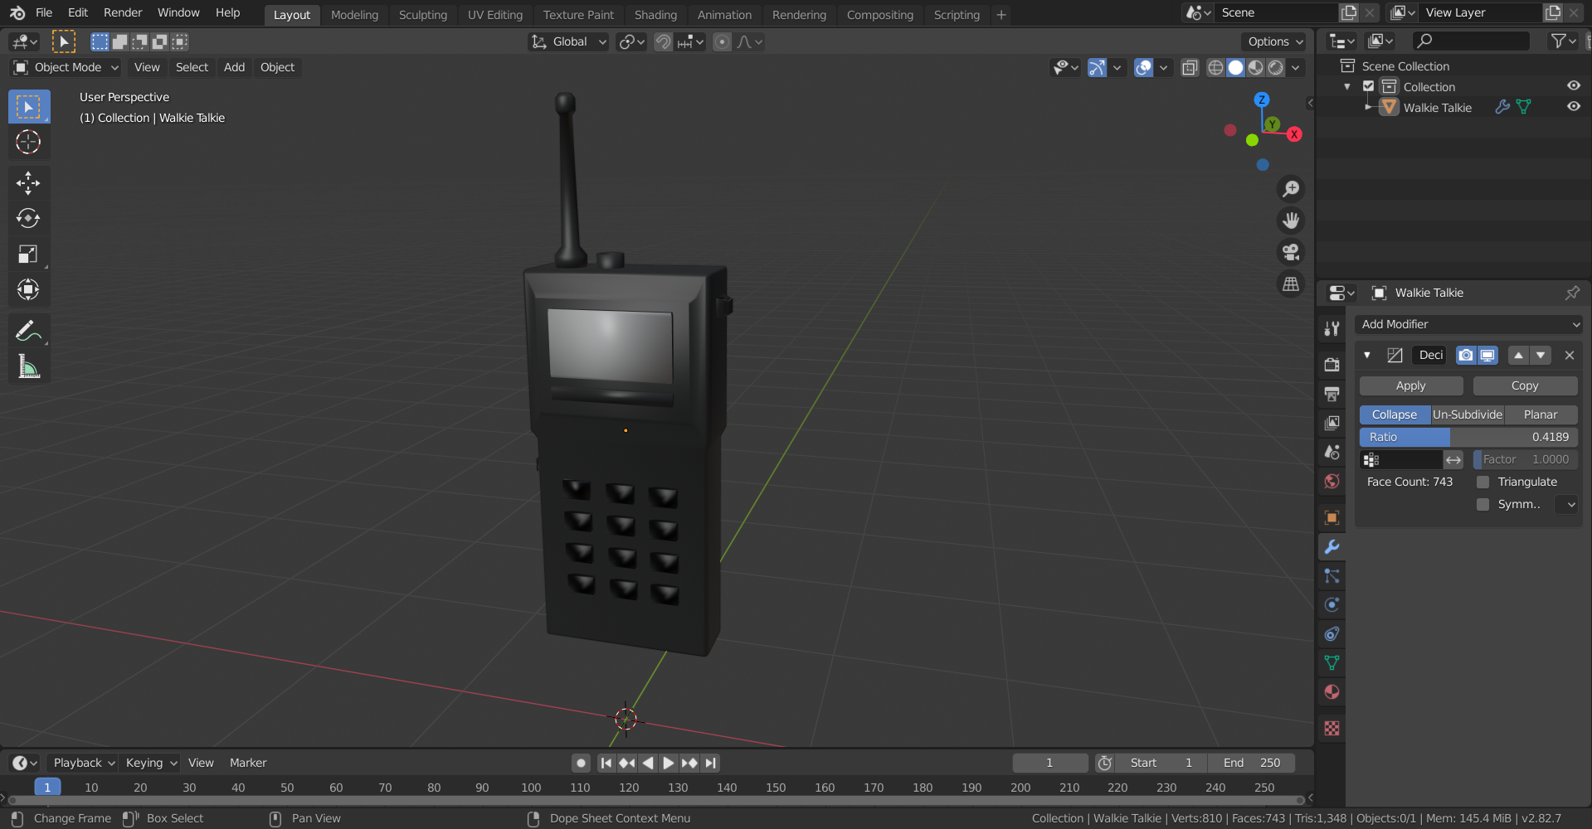
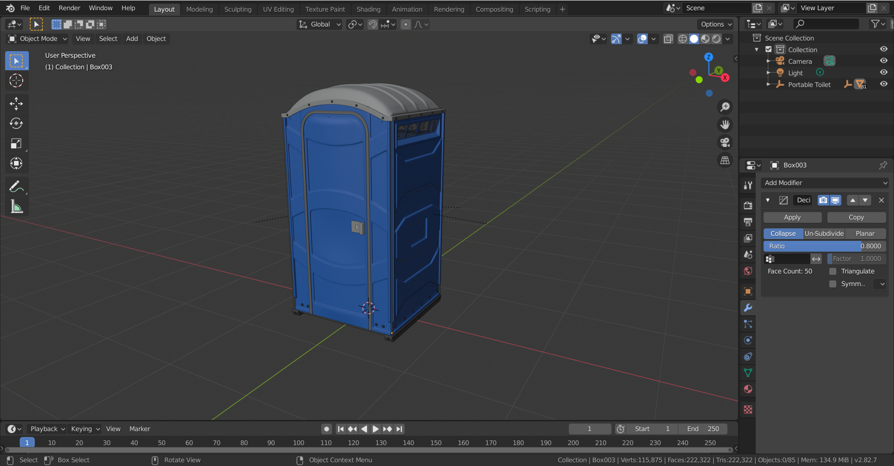
Optimization of Objects
With the ‘Decimate’ tool, we reduced the face count of the objects.
(Can see the decrease in face count on the bottom right)

Slide 21
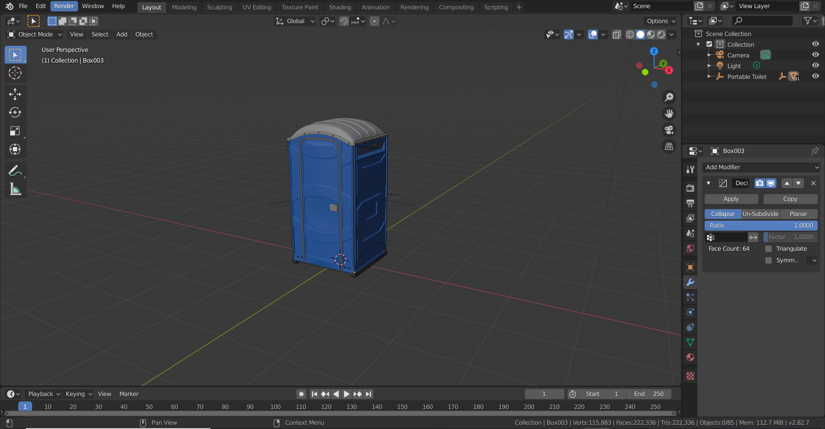
Optimization of Object – Toilet (Before)

Slide 22
Optimization of Object – Toilet (After)

Slide 23
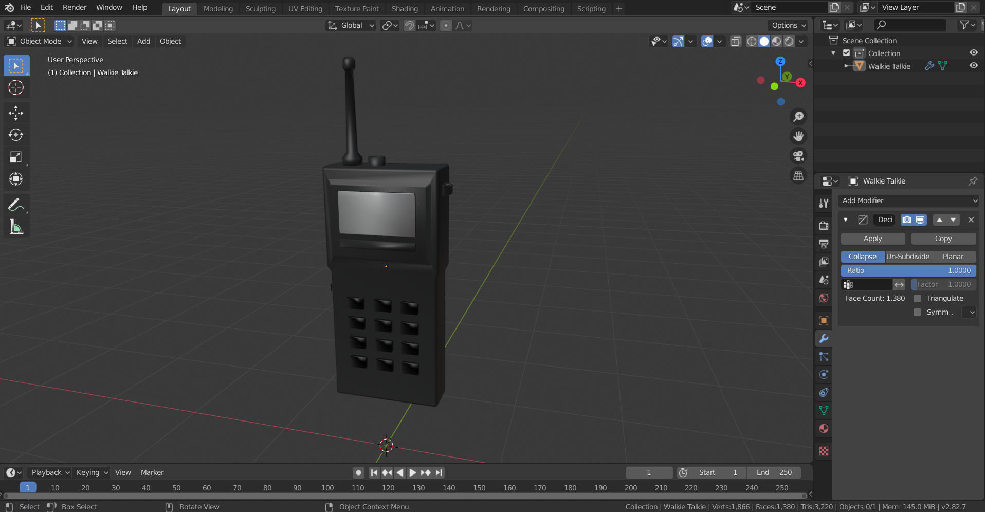
Optimization of Object – Walkie Talkie

Slide 24
Optimization of Object – Walkie Talkie

Slide 25
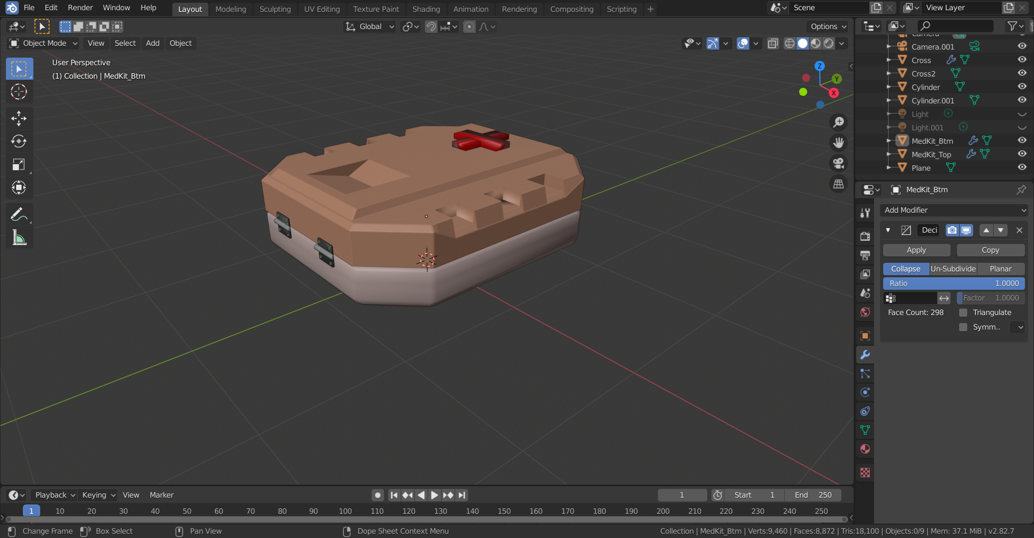
Optimization of Object – Med Kit

Slide 26
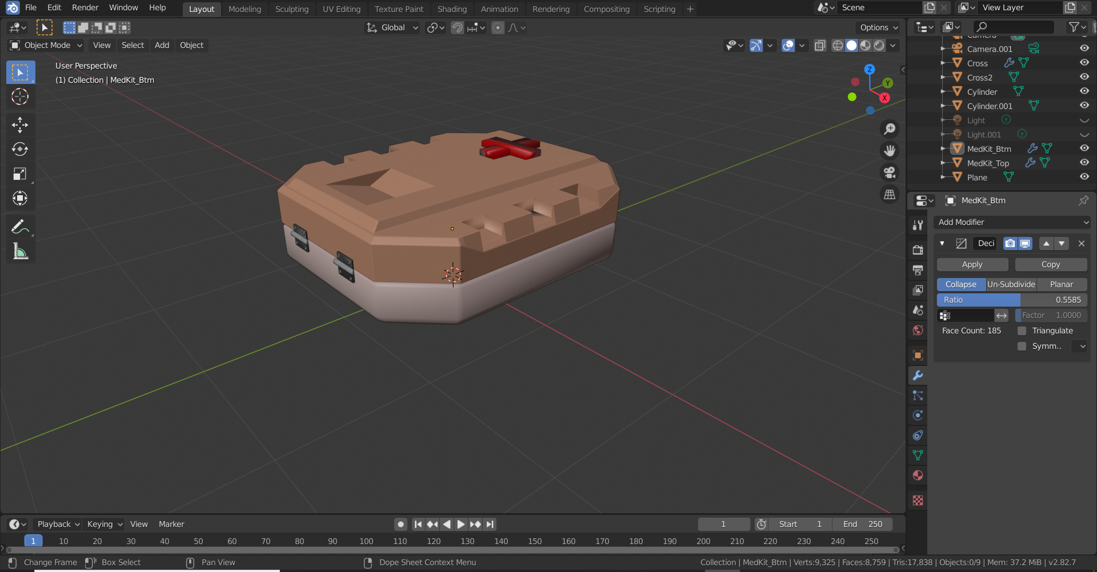
Optimization of Object – Med Kit

Slide 27

End of slides ☺

